Slide 1

Lecture
on
“Advanced Computer Architecture –TCS 704”
by
Akansha Gupta
DEPARTMENT OF COMPUTER SCIENCE AND ENGINEERING
GRAPHIC ERA DEEMED TO BE UNIVERSITY – 248002

Slide 2
Cache Associativity

Slide 3
Cache Mapping
Just as bookshelves come in different shapes and sizes, caches can also take on a variety of forms and capacities. But no matter how large or small they are, caches fall into one of three categories: direct mapped, n-way set associative, and fully associative.

Slide 4
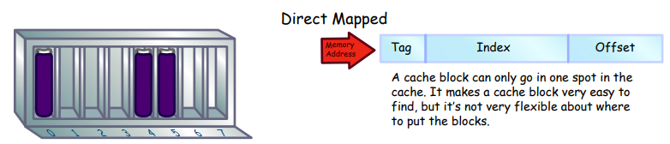
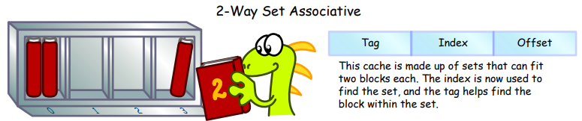
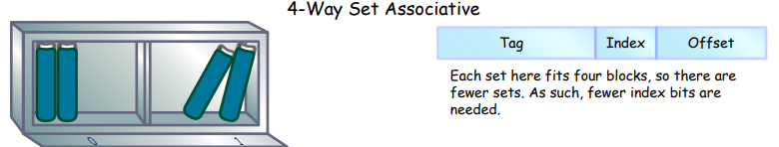

Slide 5
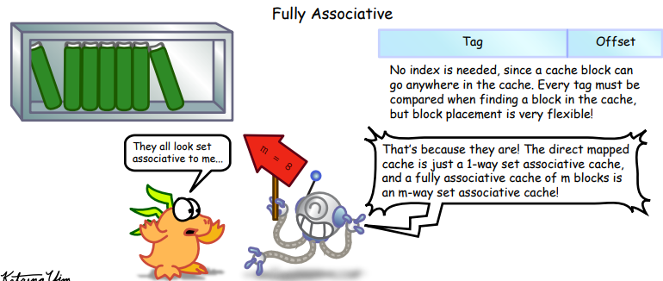

Slide 6
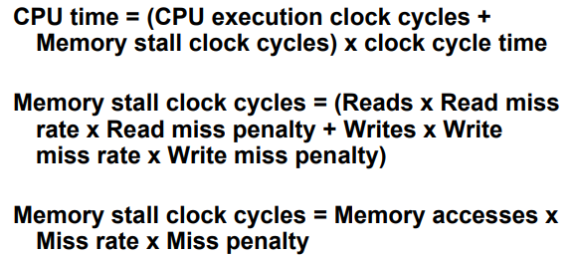
Cache Performance

Slide 7
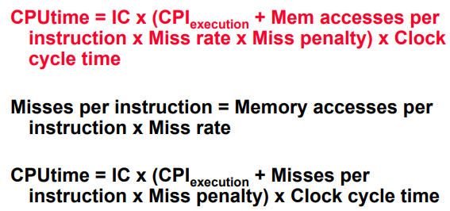

Slide 8
Improving Cache Performance
Reduce the miss rate,
Reduce the miss penalty,
Reduce the time to hit in the cache.

Slide 9
Reducing Misses
Sometimes, the cache doesn‛t have the memory block the computer‛s looking for. When this happens, it‛s called a cache miss. There are three causes of cache misses. Just remember the three C‛s:
Compulsory
(Misses in Infinite Cache)
2. Capacity
(Misses in Fully Associative Size X Cache)
3. Conflict
(Misses in N-way Associative, Size X Cache)

Slide 10
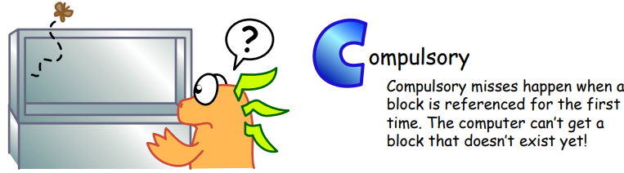
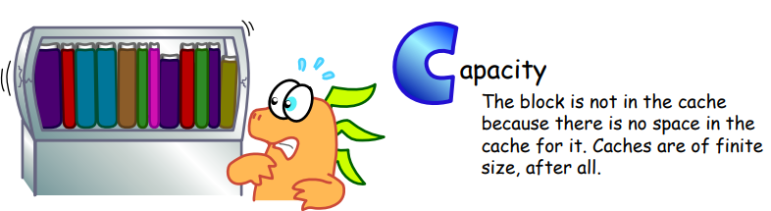
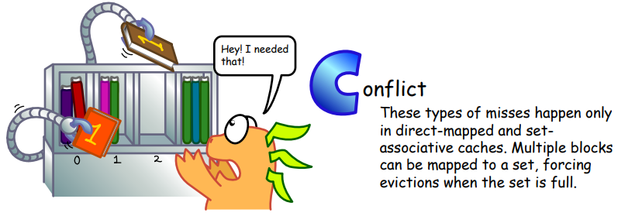

Slide 11
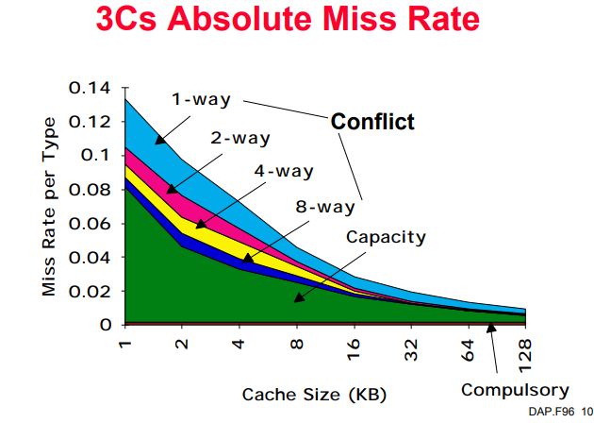

Slide 12
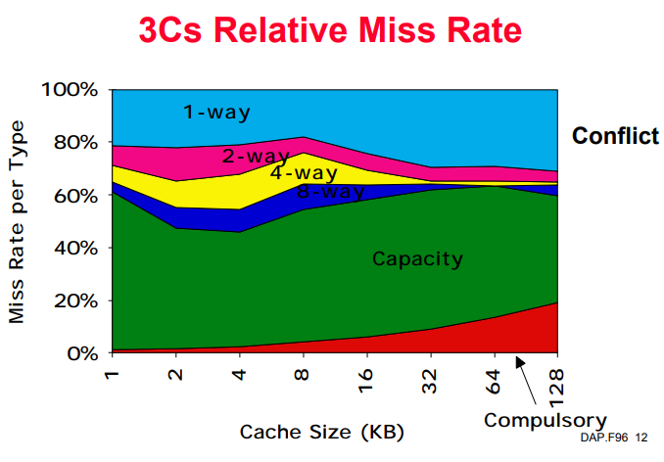

Slide 13
https://youtu.be/-Zj5Ei5kvU4
THANKS

